Slide 1

Analyzing Team Performance, New Opportunities and Revenue Generation

Slide 2


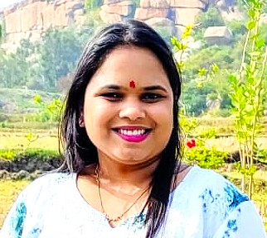


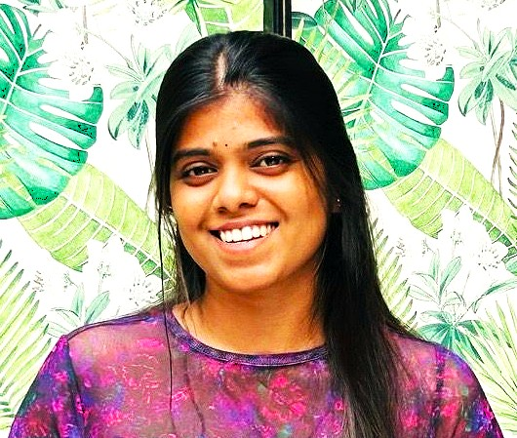
Team
Bhakti
Sanjivani
Pooja
Mallika
Sneha
Sayali

Slide 3

Agenda
Introduction
Project Overview
KPIs Used
Project Objectives
Tools and Modules Used
Dataset Description
Data Analysis Process
Dashboards
SQL Queries
KPI Summary Table
Insights & Key Findings
Recommendations
Limitations & Future Scope
Conclusion

Slide 4

Introduction
This project focuses on analyzing insurance business data.
The aim was to extract insights and improve strategic decision-making.
We used multiple tools for a complete data analysis lifecycle – from cleaning to dashboarding.

Slide 5
Project Overview
Data Cleaning and Preparation
KPI Analysis
Visualization in Excel, Power BI, and Tableau
Dashboard Creation
SQL Querying

Slide 6

KPIs Used
1. No. of Invoice by Account Exceutive
2. Yearly Meeting Count
3. 1. Cross sell : Target, Achieve, New
2. New : Target, Achieve, New
3. Renewal : Target, Achieve, New
4. Stage Funnel by Revenue
5. No. of Meeting by Account Executive
6. Top Open Opportunity

Slide 7
Project Objectives
To analyze performance of account executives.
To evaluate revenue generation across cross sell, new business, and renewals.
To identify top open opportunities and funnel stages.
To build interactive dashboards for business monitoring.

Slide 8





Tools & Modules Used
Microsoft Excel – Data Cleaning, Pivot Tables
SQL – Data Queries, Filtering, Aggregation
Power BI – Dynamic Dashboards, Slicers, DAX
Tableau – Advanced Visualization, Interactivity

Slide 9
Dataset Description
Source : Insurance dataset
Tables included : Brokerage, Fees, Individual Budgets, Invoice, Meeting, Opportunity, Policy Data
Fields included : Account Executive Name, Invoice Numbers, Meeting Counts, Product groups and Revenue stages, Cross Sell / New / Renewal Targets and Achievements
Time Period : 2019–2020

Slide 10
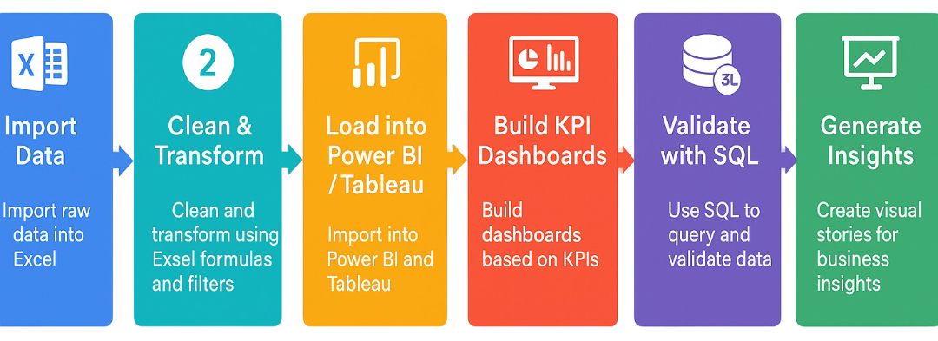
Data Analysis Process

Slide 11
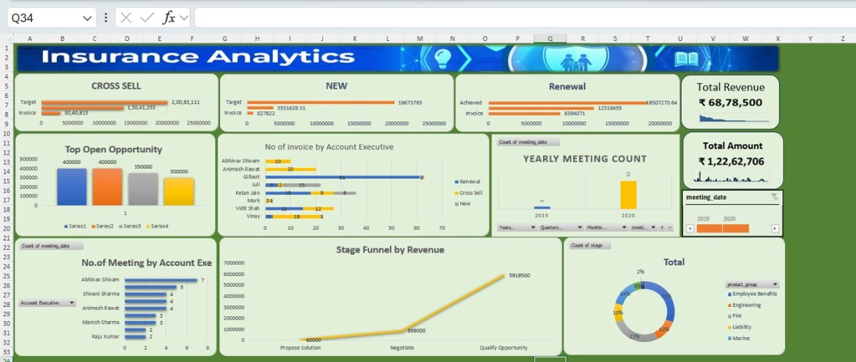
Excel Dashboard

Slide 12
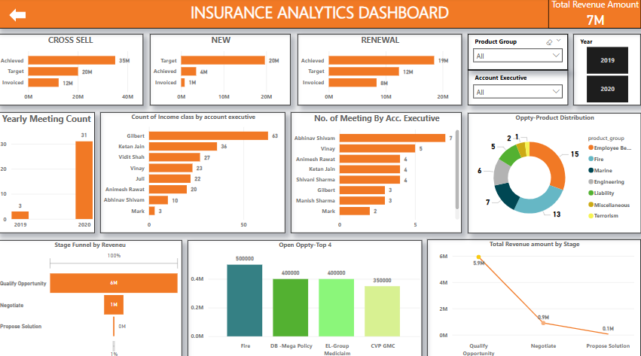
Power BI Dashboard

Slide 13
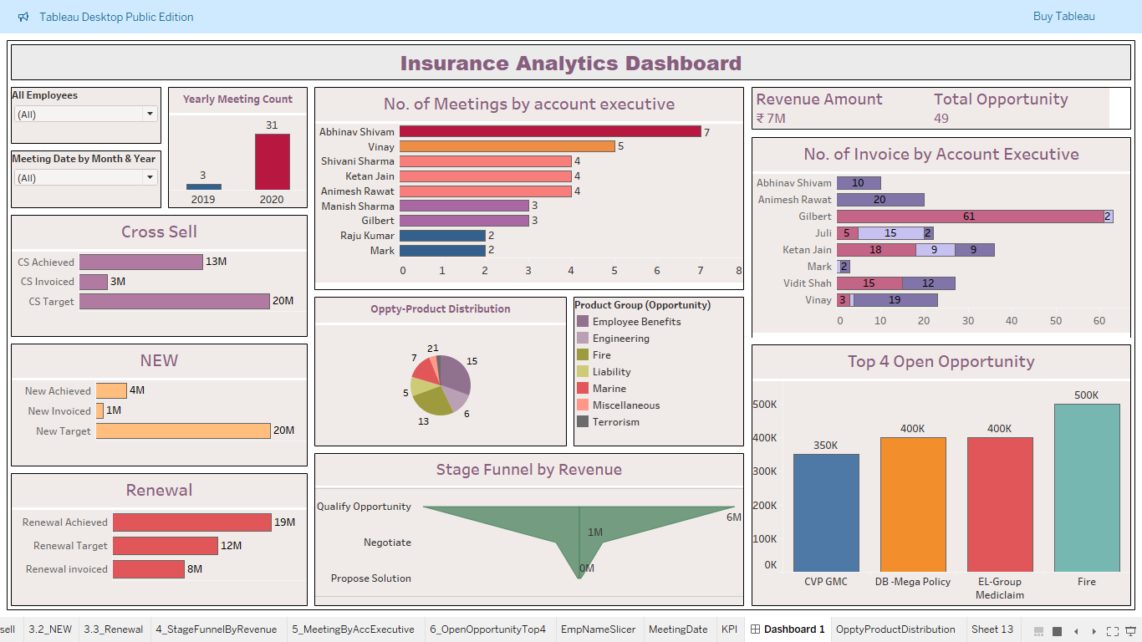
Tableau Dashboard

Slide 14
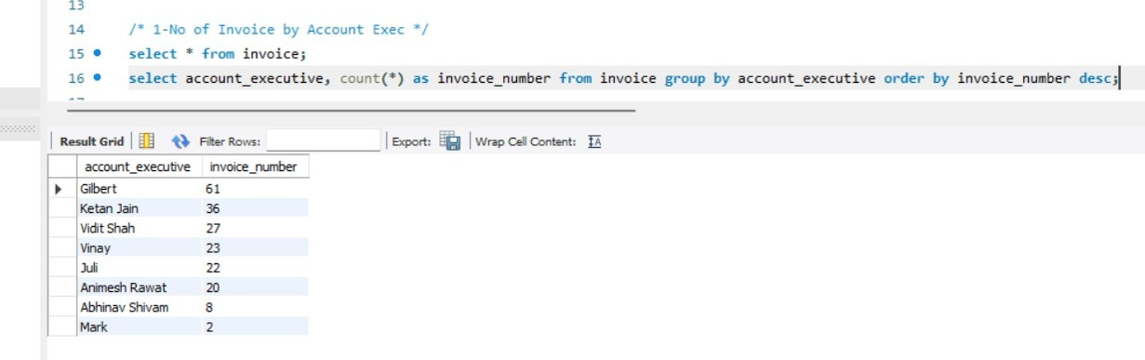
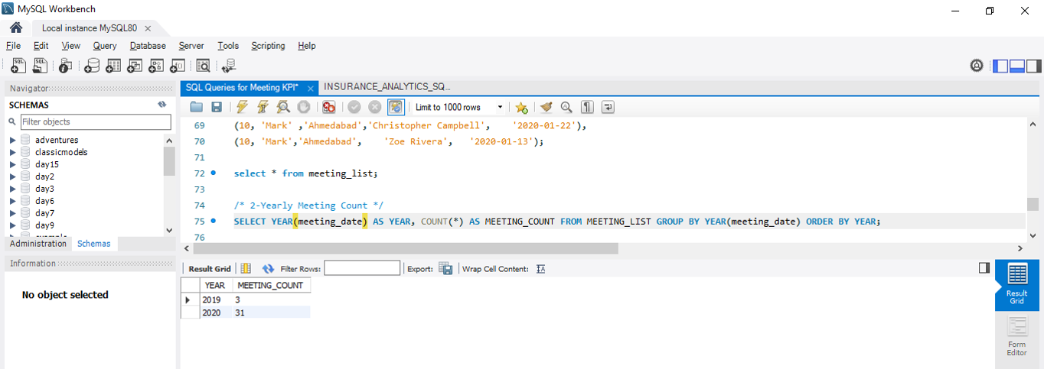
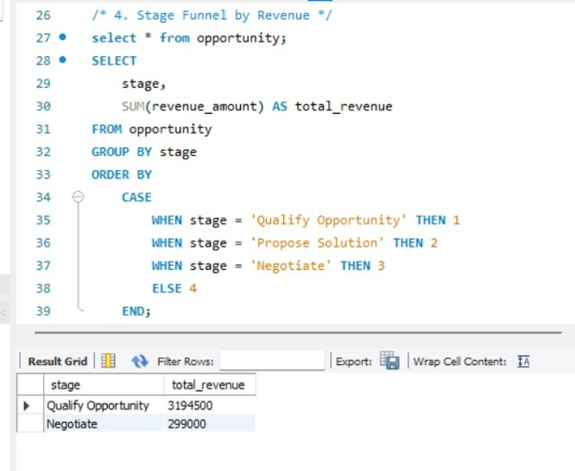
SQL Queries
No. of Invoice by Account Exceutive
Yearly Meeting Count
Stage Funnel by Revenue

Slide 15
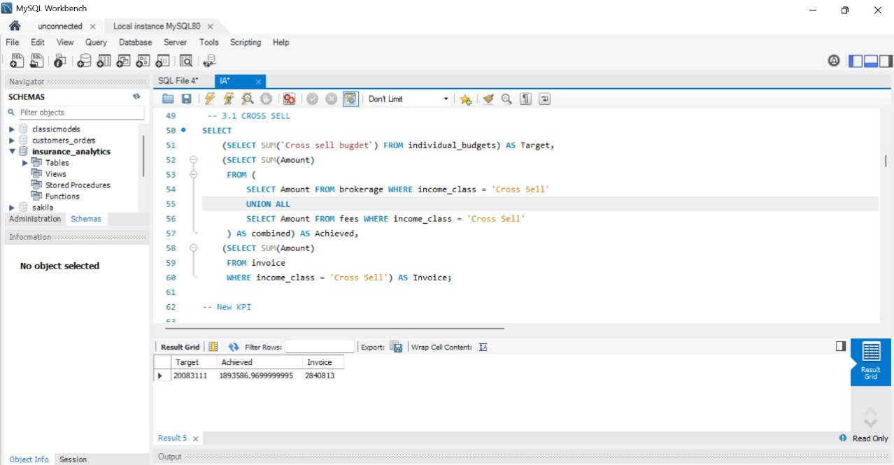
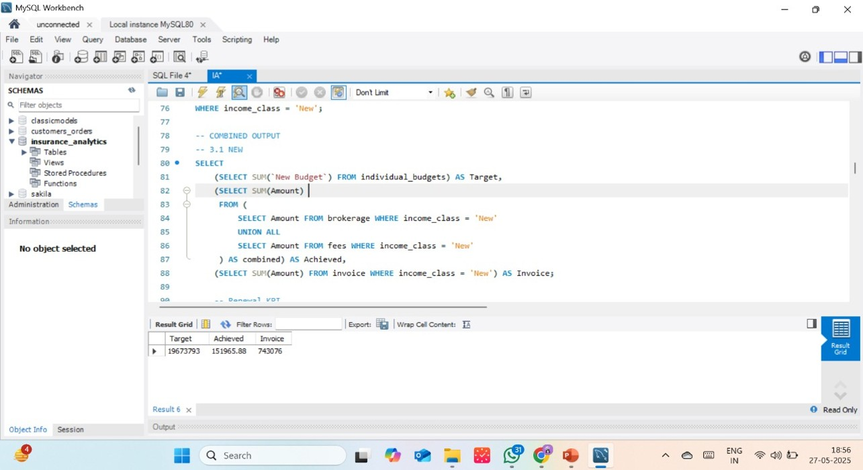
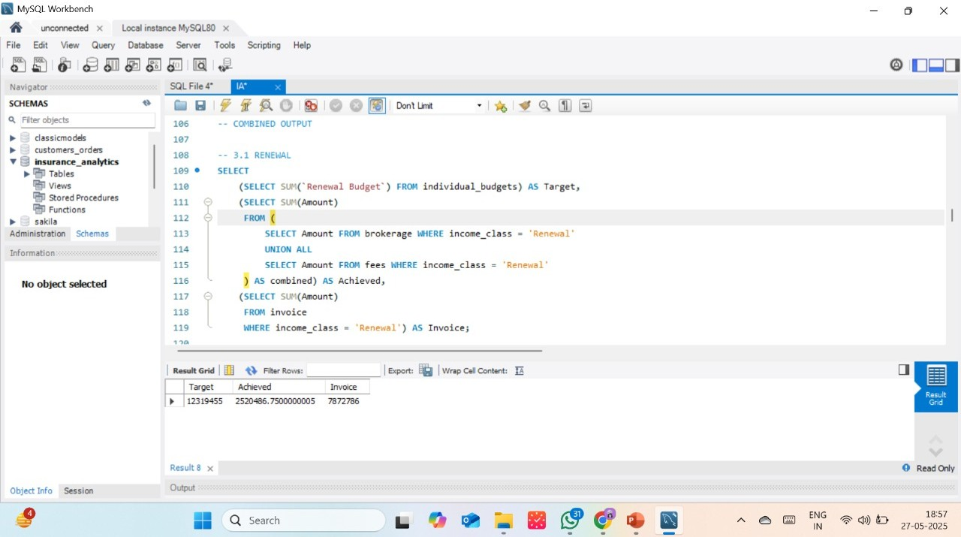
SQL Queries
Cross sell : Target, Achieve, New
New : Target, Achieve, New
Renewal : Target, Achieve, New

Slide 16
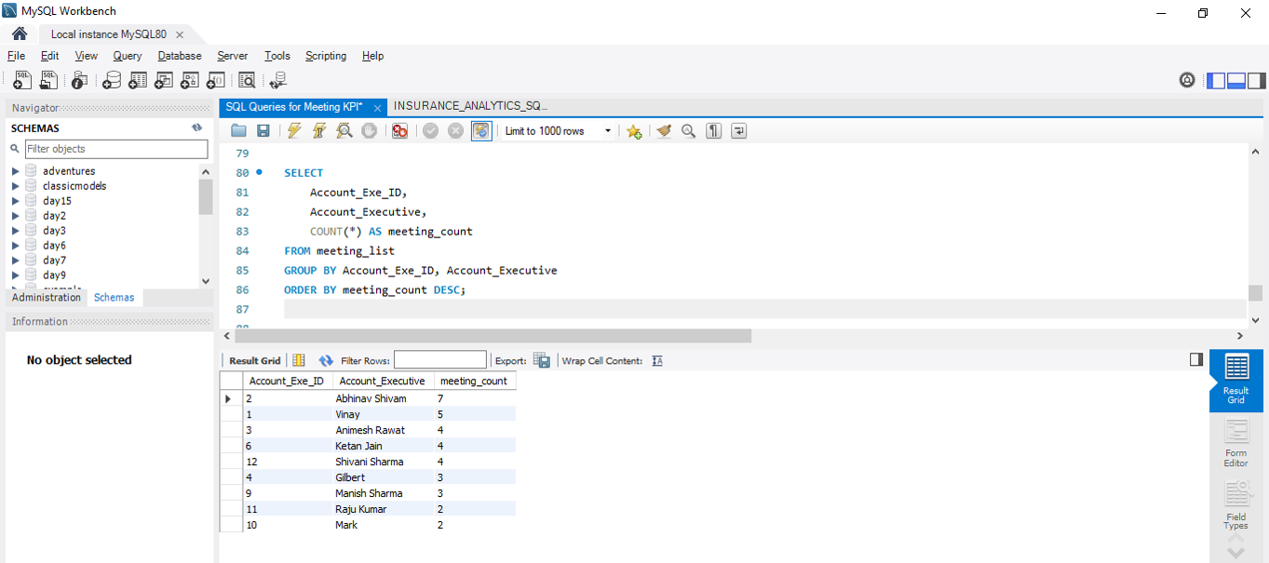
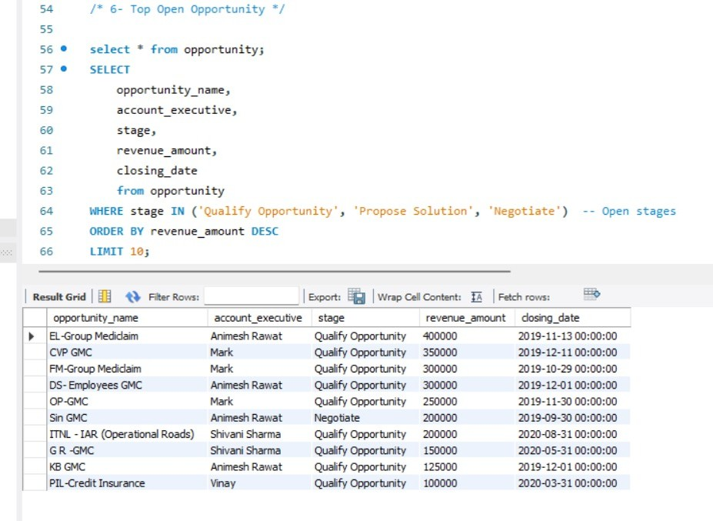
SQL Queries
No. of Meeting by Account Executive
Top Open Opportunity

Slide 17
KPI Summary Table
KPI Name | Metric Type | Purpose
No. of Invoices by Executive | Count | Measure billing activity by each executive
Yearly Meeting Count | Count (Year-wise) | Track employee engagement
Cross Sell – Target, Achieved | Target vs Actual | Evaluate cross-selling performance
New Business – Target, Achieved | Target vs Actual | Analyse new customer acquisitions
Renewal – Target, Achieved | Target vs Actual | Track policy renewals
Funnel by Revenue Stage | Funnel Analysis | Visualize sales stage performance
Top Open Opportunities | Ranking / Amount | Identify potential high-value deals

Slide 18
Insights & Key Findings
Cross-sell targets were underachieved—needs focus.
Most revenue came from “Propose Solution” and “Negotiate” stages.
A few top-value opportunities remain open—high closure potential.
Executives with more meetings performed better.
Some executives showed low activity—needs review.

Slide 19

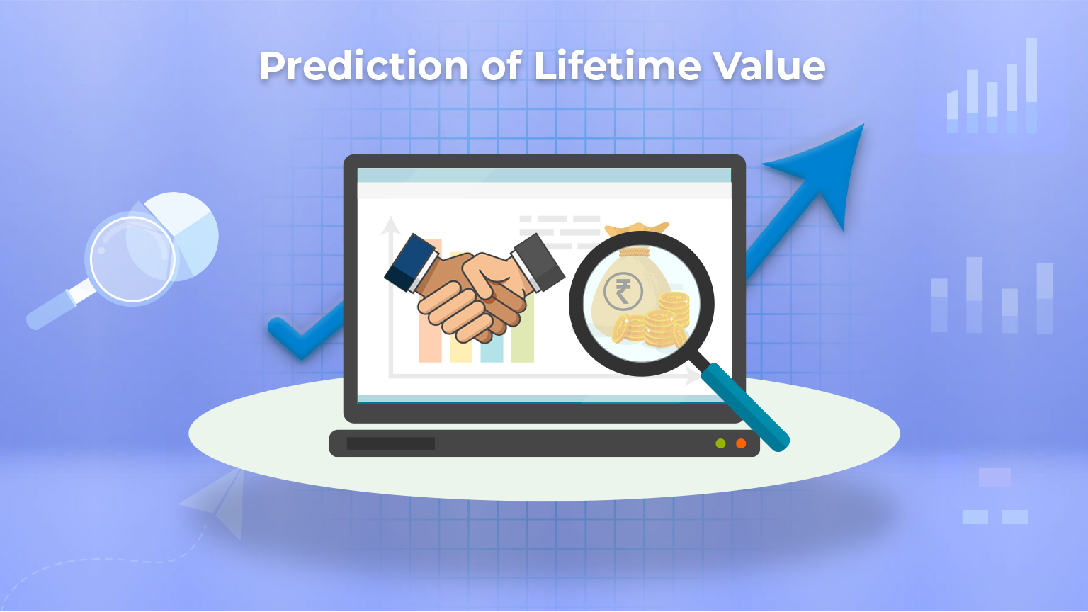
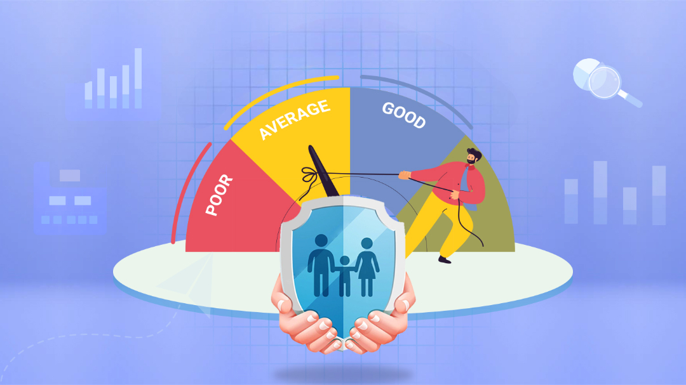
Recommendations
Focus more on cross sell to reach the target
Optimize low-performing funnel stages (e.g., "Propose Solution")
Regularly monitor top open opportunities for quick closure
Encourage executives with fewer meetings to improve engagement

Slide 20
Limitations & Future Scope
Limitations :
Future Scope :
Data limited to 2019–2020.
Missing details like customer feedback and loss reasons.
Static analysis, no real-time or predictive insights.
Add ML models for revenue prediction.
Set up alerts for low engagement.
Include client segmentation for targeted strategy.

Slide 21
Conclusion
Multi-tool integration gave us strong control over data
Visual insights help management understand key metrics easily
SQL supported backend accuracy and filtering
Project enhances business decisions in the insurance domain
Delivered insights on performance, meetings, revenue & opportunities

Slide 22

Thank You!

